Slide 1
Decision Trees

Slide 2
Introduction

Slide 3
Contents
•What is segmentation
•What is a Decision tree
•Decision Trees Algorithm
•Best Splitting attribute
•Building decision Trees
•Tree validation
•Pruning
•Prediction using the model

Slide 4
What is Segmentation?

Slide 5
What is Segmentation?
•Imagine a scenario where we want to run a SMS marketing campaign to attract more customers in the next quarter
•Some customers like to see high discount
•Some customers want to see a large collection of items
•Some customers are fans of particular brands
•Some customers are Male some are Female
•Divide them based on their demographics, buying patterns and profile related attributes

Slide 6
What is Segmentation?
•One size doesn't fit all
•Divide the population in such a way that
•Customers inside a group are homogeneous
•Customers across groups are heterogeneous
•Is there any statistical way of dividing them correctly based on the data

Slide 7
Segmentation Business Problem

Slide 8
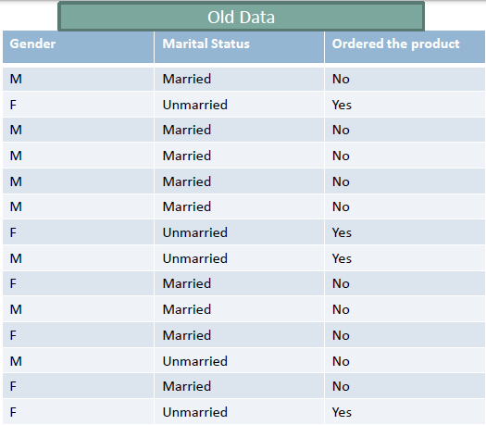
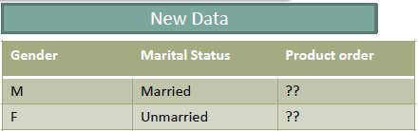
The Business Problem

Slide 9
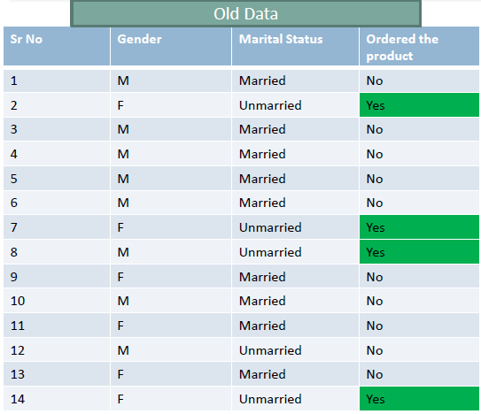
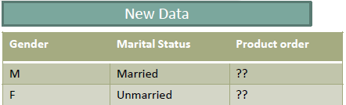
The Business Problem

Slide 10
The Decision Tree Philosophy

Slide 11
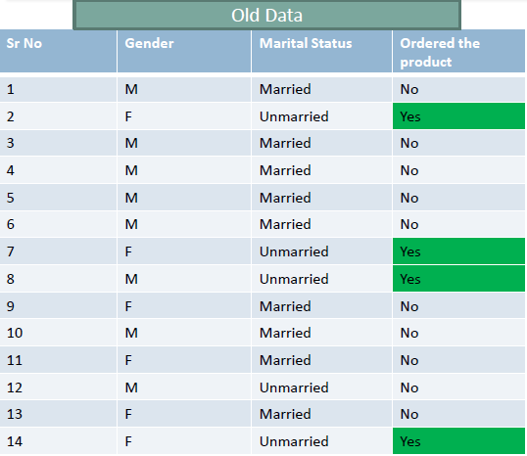
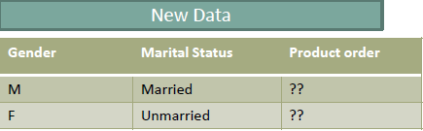
The Data

Slide 12
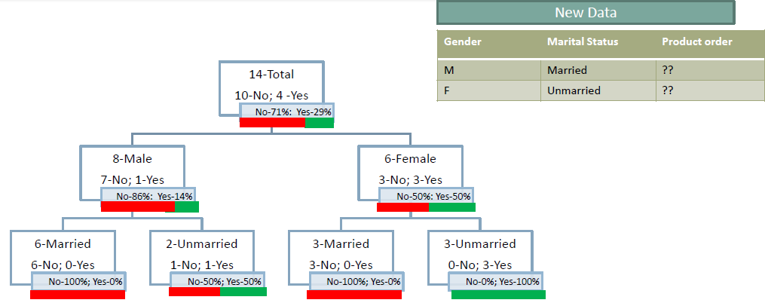
Re-Arranging the data

Slide 13
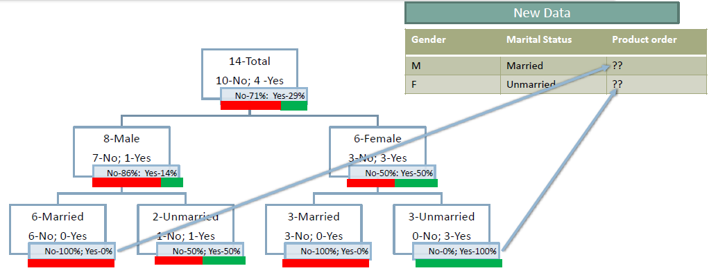
Re-Arranging the data

Slide 14
The Decision Tree Approach

Slide 15
The Decision Tree Approach
•The aim is to decide the whole population or the data set into segments
•The segmentation need to be useful for business decision making.
•If one class is really dominating in a segments
•Then it will be easy for us to classify the unknown items
•Then its very easy for applying business strategy
•For example:
•It takes no great skill to say that the customers have 50% chance to buy and 50% chance to not buy.
•A good splitting criterion segments the customers with 90% -10% buying probability, say Gender=“Female” customers have 5% buying probability and 95% not buying

Slide 16
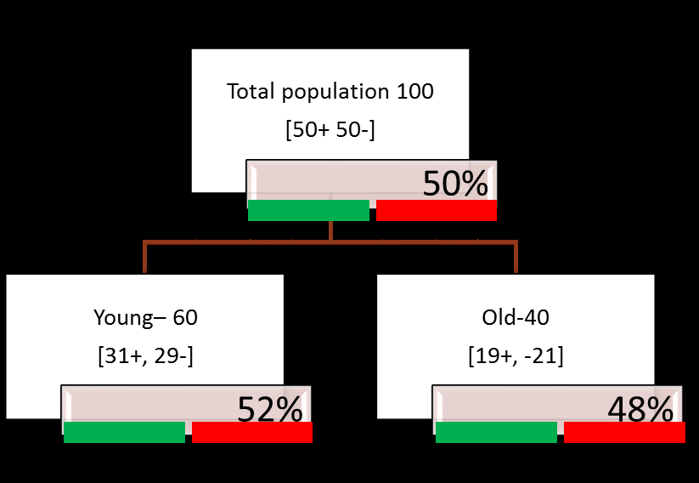
Example Sales Segmentation Based on Age

Slide 17
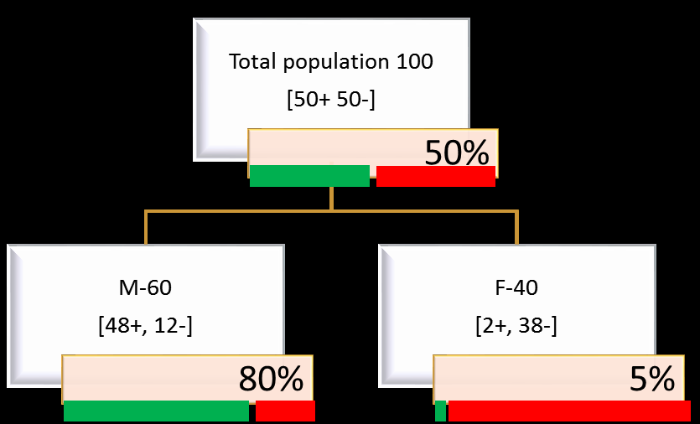
Example Sales Segmentation Based on Gender

Slide 18
Main questions
•Ok we are looking for pure segments
•Dataset has many attributes
•Which is the right attribute for pure segmentation?
•Can we start with any attribute?
•Which attribute to start? –The best separating attribute
•Customer Age can impact the sales, gender can impact sales , customer place and demographics can impact the sales. How to identify the best attribute and the split?

Slide 19
The Splitting Criterion

Slide 20
The Splitting Criterion
•The best split is
•The split does the best job of separating the data into groups
•Where a single class(either 0 or 1) predominates in each group

Slide 21
Example Sales Segmentation Based on Age

Slide 22
Example Sales Segmentation Based on Gender

Slide 23
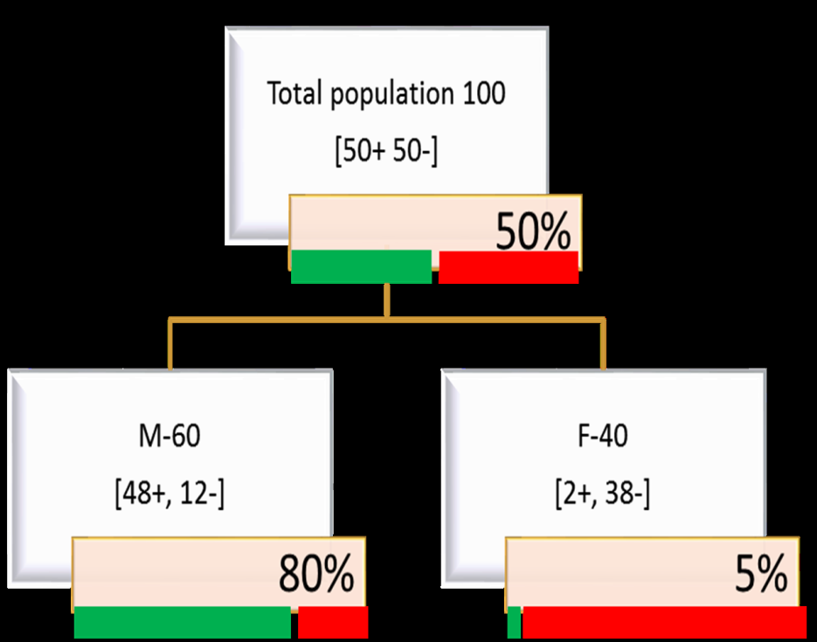
Impurity (Diversity) Measures:
•We are looking for a impurity or diversity measure that will give high score for this Age variable(high impurity while segmenting), Low score for Gender variable(Low impurity while segmenting)

Slide 24
Impurity (Diversity) Measures:
•Entropy: Characterizes the impurity/diversity of segment
•Measure of uncertainty/Impurity
•Entropy measures the information amount in a message
•S is a segment of training examples, p+is the proportion of positive examples, p-is the proportion of negative examples
•Entropy(S) = -p+log2p+-p-log2p-
•Where p+is the probabailty of positive class and p-is the probabailty of negative class
•Entropy is highest when the split has p of 0.5.
•Entropy is least when the split is pure .ie p of 1

Slide 25
Entropy is highest when the split has p of 0.5
•Entropy(S) = -p+log2p+-p-log2p-
•Entropy is highest when the split has p of 0.5
•50-50 class ratio in a segment is really impure, hence entropy is high
•Entropy(S) = -p+log2p+-p-log2p-
•Entropy(S) = -0.5*log2(0.5) -0.5*log2(0.5)
•Entropy(S) = 1

Slide 26
Entropy is least when the split is pure .iep of 1
•Entropy(S) = -p+log2p+-p-log2p-
•Entropy is least when the split is pure .ie p of 1
•100-0 class ratio in a segment is really pure, hence entropy is low
•Entropy(S) = -plog2p-qlog2q
•Entropy(S) = -1*log2(1) -0*log2(0)
•Entropy(S) = 0

Slide 27
The less the entropy, the better the split
•The less the entropy, the better the split
•Entropy is formulated in such a way that, its value will be high for impure segments

Slide 28
Entropy Calculation -Example

Slide 29
Entropy Calculation
•Entropy at root
•Total population at root 100 [50+,50-]
•Entropy(S) = -p+log2p+-p-log2p-
•-0.5 log2(0.5) -0.5 log2(0.5)
•-(0.5)*(-1) -(0.5)*(-1)
•1
•100% Impurity at root
Entropy(S) = -p+ log2 p+ -p-log2 p-

Slide 30
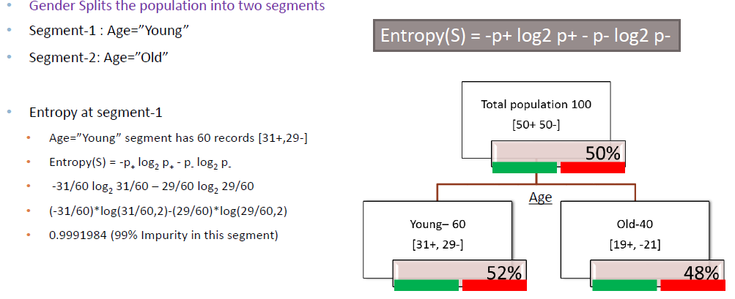
Entropy Calculation

Slide 31
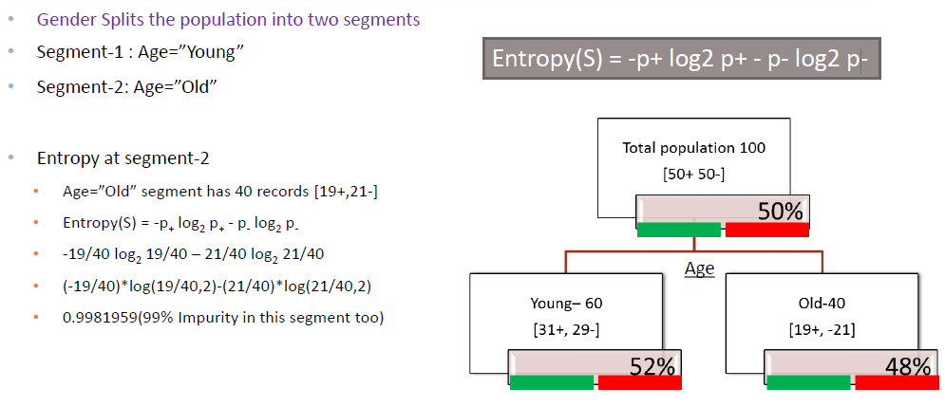
Entropy Calculation

Slide 32
LAB: Entropy Calculation -Example

Slide 33
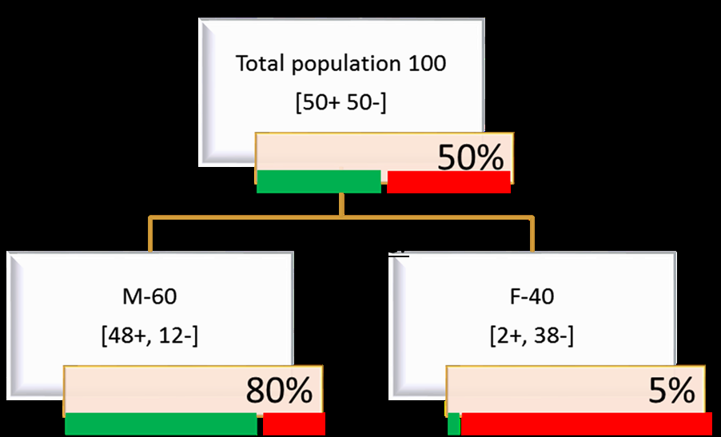
LAB Entropy Calculation
•Calculate entropy at the root for the given population
•Calculate the entropy for the two distinct gender segments

Slide 34
Code-Entropy Calculation
•Entropy at root 100%
•Male Segment : (-48/60)*log(48/60,2)-(12/60)*log(12/60,2)
•0.7219281
•FemaleSegment : (-2/40)*log(2/40,2)-(38/40)*log(38/40,2)
•0.286397

Slide 35
Information Gain

Slide 36
Information Gain
•Information Gain= entropyBeforeSplit–entropyAfterSplit
•Easy way to understand Information gain= (overall entropy at parent node) –(sum of weighted entropy at each child node)
•Attribute with maximum information is best split attribute

Slide 37
Information Gain-Calculation

Slide 38


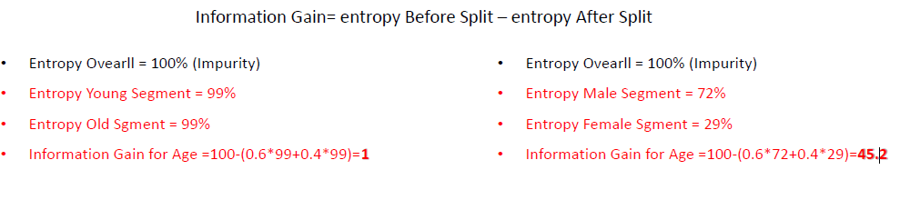
Information Gain-Calculation

Slide 39
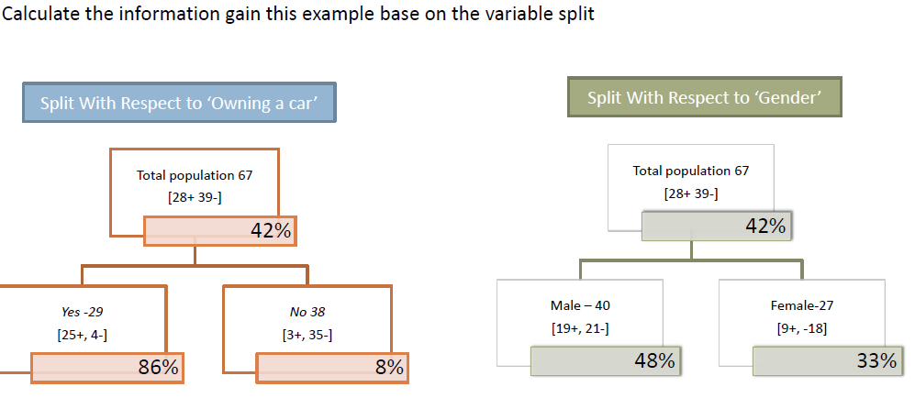
LAB: Information Gain

Slide 40
Output-Information Gain
•Entropy([28+,39-]) Ovearll = -28/67 log228/67 –39/67 log239/67 = 98% (Impurity)
•Entropy([25+,4-]) Owing a car = 57%
•Entropy([3+,35-]) No car = 40%
•Information Gain for Owing a car =98-((29/67)*57+(38/67)*40)=50.6
•Entropy([19+,21-]) Male= 99%
•Entropy([9+,18-]) Female = 91%
•Information Gain for Gender=98-((40/67)*99+(21/67)*91) =10.3

Slide 41
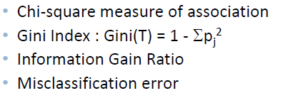
Other Purity (Diversity) Measures

Slide 42
The Decision tree Algorithm

Slide 43
The Decision tree Algorithm
•The major step is to identify the best split variables and best split criteria
•Once we have the split then we have to go to segment level and drill down further

Slide 44
The Decision tree Algorithm
Until stopped:
1.Select a leaf node
2.Find the best splitting attribute
3.Spilt the node using the attribute
4.Go to each child node and repeat step 2 & 3
Stopping criteria:
•Each leaf-node contains examples of one type
•Algorithm ran out of attributes
•No further significant information gain

Slide 45
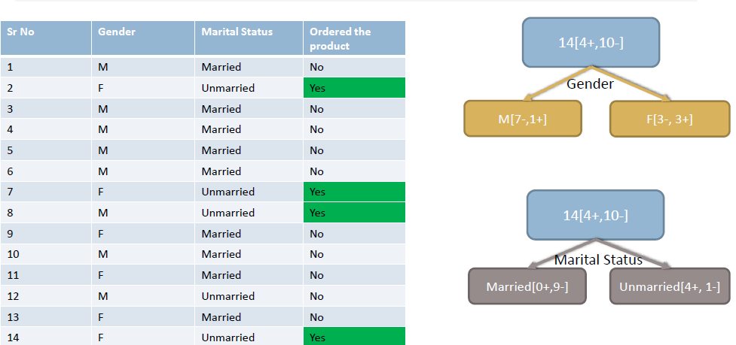
The Decision tree Algorithm-Demo

Slide 46
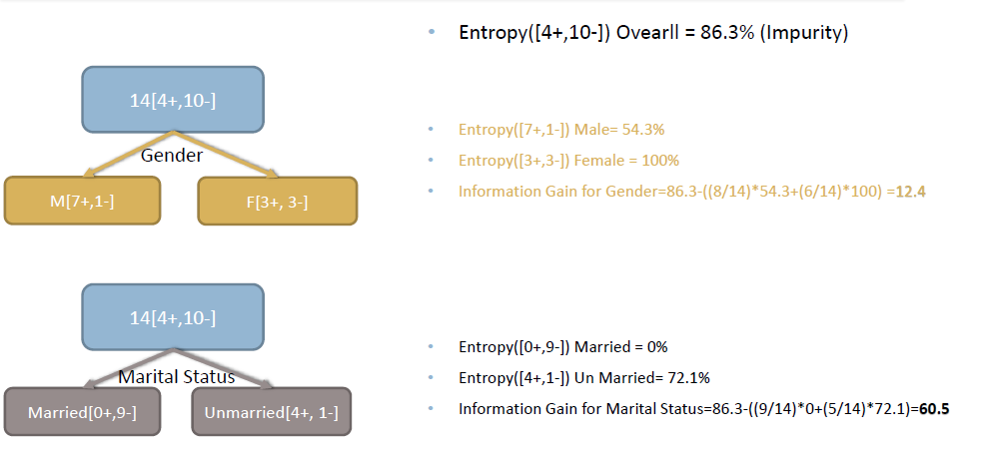
The Decision tree Algorithm-Demo

Slide 47
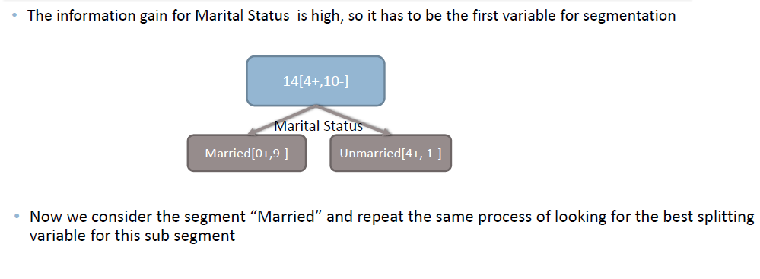
The Decision tree Algorithm-Demo

Slide 48
The Decision tree Algorithm
Until stopped:
1.Select a leaf node
2.Find the best splitting attribute
3.Spilt the node using the attribute
4.Go to each child node and repeat step 2 & 3
Stopping criteria:
•Each leaf-node contains examples of one type
•Algorithm ran out of attributes
•No further significant information gain

Slide 49
Many Splits for a single variable

Slide 50
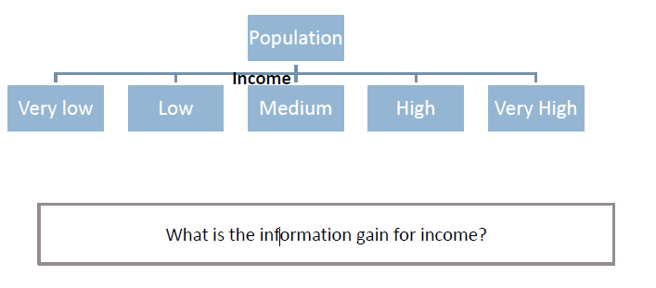
Many Splits for a single variable
•Sometimes we may find multiple values taken by a variable
•which will lead to multiple split options for a single variable
•that will give us multiple information gain values for a single variable

Slide 51
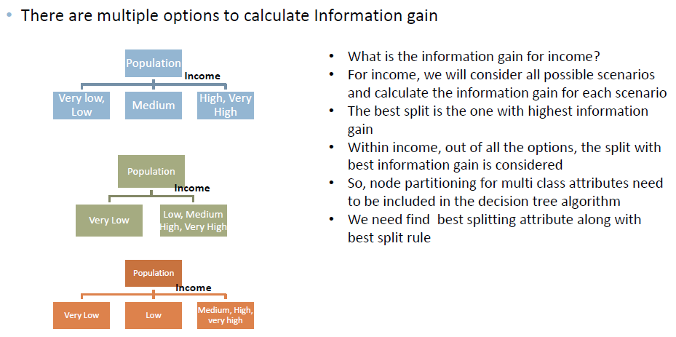
Many Splits for a single variable

Slide 52
The Decision tree Algorithm-Full version
Until stopped:
1.Select a leaf node
2.Select an attribute
•Partition the node population and calculate information gain.
•Find the split with maximum information gain for a this attribute
3.Repeat this for all attributes
•Find the best splitting attribute along with best split rule
4.Spilt the node using the attribute
5.Go to each child node and repeat step 2 to 4
Stopping criteria:
•Each leaf-node contains examples of one type
•Algorithm ran out of attributes
•No further significant information gain

Slide 53
LAB: Decision Tree Building

Slide 54
LAB: Decision Tree Building
•Data:Ecom_Cust_Relationship_Management/Ecom_Cust_Survey.csv
•How many customers have participated in the survey?
•Overall most of the customers are satisfied or dis-satisfied?
•Can you segment the data and find the concentrated satisfied and dis-satisfied customer segments ?
•What are the major characteristics of satisfied customers?
•What are the major characteristics of dis-satisfied customers?

Slide 55
Code-Decision Tree Building
rpart(formula, method, data, control)
•Formula : y~x1+x2+x3
•method: “Class” for classification trees , “anova” for regression trees with continuous output
•For controlling tree growth. For example, control=rpart.control(minsplit=30, cp=0.001)
•Minsplit: Minimum number of observations in a node be 30 before attempting a split and that
•A split must decrease the overall lack of fit by a factor of 0.001 (cost complexity factor) before being attempted.(details later)

Slide 56
Tree Validation

Slide 57
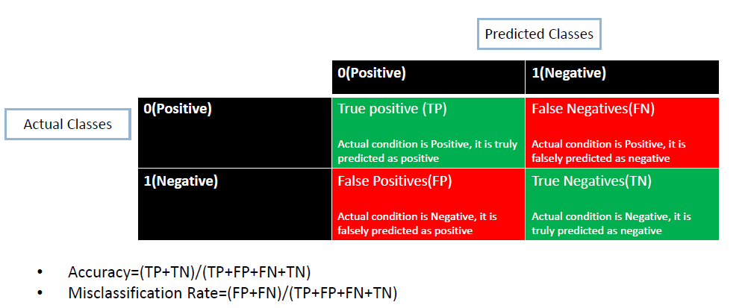
Classification Table & Accuracy

Slide 58
LAB: Tree Validation

Slide 59
LAB: Tree Validation
•Create the confusion matrix for the model
•Find the accuracy of the classification for the Ecom_Cust_Surveymodel

Slide 60
The Problem of Overfitting

Slide 61
LAB: The Problem of Overfitting
•Dataset: “Buyers Profiles/Train_data.csv”
•Import both test and training data
•Build a decision tree model on training data
•Find the accuracy on training data
•Find the predictions for test data
•What is the model prediction accuracy on test data?

Slide 62
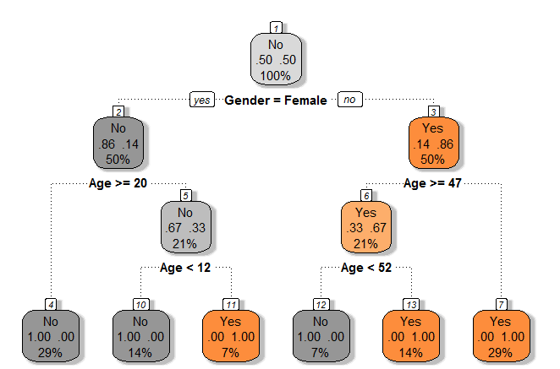
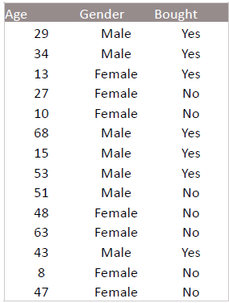
The Problem of Overfitting
•Build a decision tree on Prune_Sample.csv

Slide 63
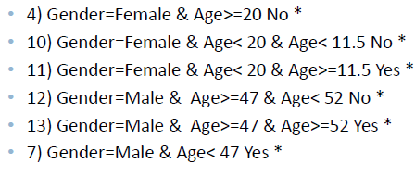
The Final Tree with Rules

Slide 64
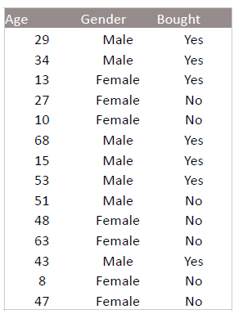
The Problem of Overfitting
•If we further grow the tree we might even see each row of the input data table as the final rules
•The model will be really good on the training data but it will fail to validate on the test data
•Growing the tree beyond a certain level of complexity leads to overfitting
•A really big tree is very likely to suffer from overfitting.

Slide 65
Pruning

Slide 66
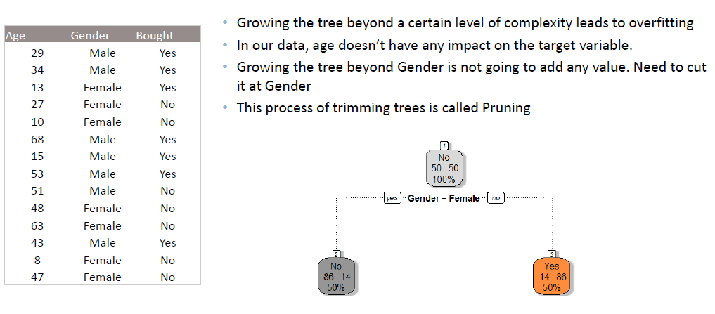
Pruning

Slide 67
Pruning to Avoid Overfitting
•Pruning helps us to avoid overfitting
•Generally it is preferred to have a simple model, it avoids overfitting issue
•Any additional split that does not add significant value is not worth while.
•We can use Cp-Complexity parameter in R to control the tree growth

Slide 68
Complexity parameter

Slide 69
Complexity parameter
•Complexity parameter is used to mention the minimum improvement before proceeding further.
•It is the amount by which splitting a node improved the relative error.
•For example, in a decision tree, before splitting the node, the error is 0.5 and after splitting the error is 0.1 then the split is useful, where as if the error before splitting is 0.5 and after splitting it is 0.48 then split didn’t really help
•User tells the program that any split which does not improve the fit by cp will likely be pruned off
•This can be used as a good stopping criterion.
•The main role of this parameter is to avoid over fitting and also to save computing time by pruning off splits that are obviously not worthwhile
•It is similar to AdjR-square. If a variable doesn’t have a significant impact then there is no point in adding it. If we add such variable adjR square decreases.
•The default is of cpis 0.01.

Slide 70
Choosing Cpand Cross Validation Error

Slide 71
Choosing Cpand Cross Validation Error
•We can choose Cp by analyzing the cross validation error.
•For every split we expect the validation error to reduce, but if the model suffers from overfitting the cross validation error increases or shows negligible improvement
•We can either rebuild the tree with updated cp or prune the already built tree by mentioning the old tree and new cp value
•printcp(tree) shows the
•Training error , cross validation error and standard deviation at each node.

Slide 72
LAB: Pruning & Choosing Cp

Slide 73
LAB: Pruning & Choosing Cp
•Rebuild the model for above data
•Draw the table and graph for Cp
•Choose the optimal Cp
•Prune the decision tree or rebuild it with optimal Cp
•What calculate the training and test error
•Check whether there is an issue of overfitting in the final model

Slide 74
Two types of pruning

Slide 75
Two types of pruning
•Pre-Pruning:
•Building the tree by mentioning Cpvalue upfront
•Post-pruning:
•Grow decision tree to its entirety, trim the nodes of the decision tree in a bottom-up fashion

Slide 76
LAB: Tree Building & Model Selection

Slide 77
LAB: Tree Building & Model Selection
•Import fiber bits data. This is internet service provider data. The idea is to predict the customer attrition based on some independent factors
•Build a decision tree model for fiber bits data
•Prune the tree if required
•Find out the final accuracy
•Is there any 100% active/inactive customer segment?

Slide 78
Conclusion

Slide 79
Conclusion
•Decision trees are powerful and very simple to represent and understand.
•One need to be careful with the size of the tree. Decision trees are more prone to overfitting than other algorithms
•Can be applied to any type of data, especially with categorical predictors
•One can use decision trees to perform a basic customer segmentation and build a different predictive model on the segments

Slide 80
Thank you

